Slide 1
Intro to Machine Learning
Supervised Vs Unsupervised Learning
Satwik Goyal

Slide 2

What is Machine Learning?
Machine learning is a branch of artificial intelligence (AI) and computer science which focuses on the use of data and algorithms to imitate the way that humans learn, gradually improving its accuracy.
-IBM

Slide 3
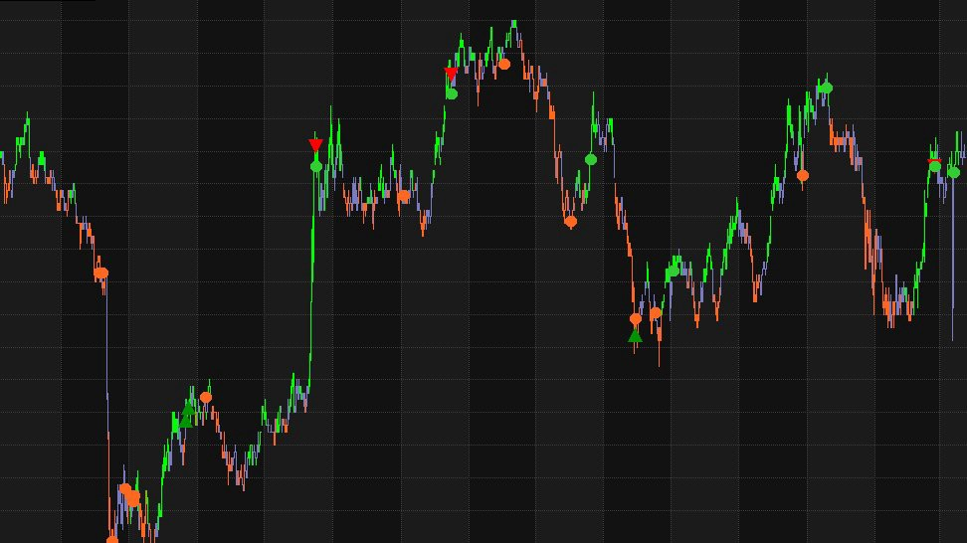
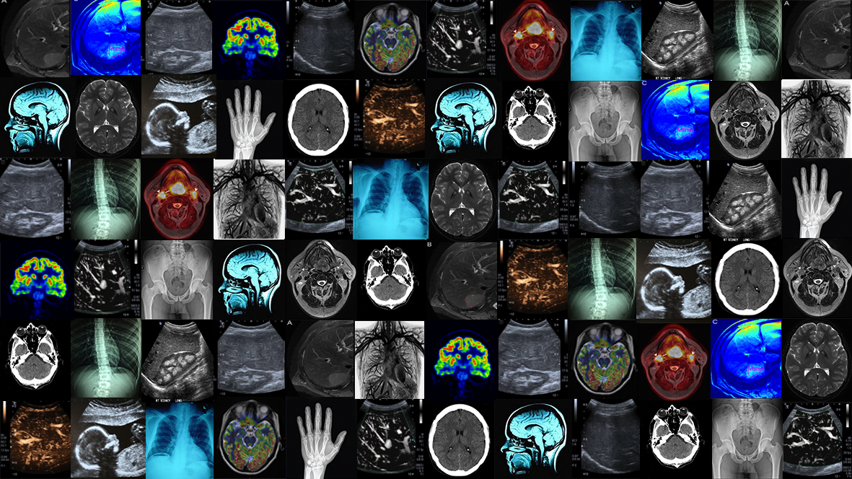
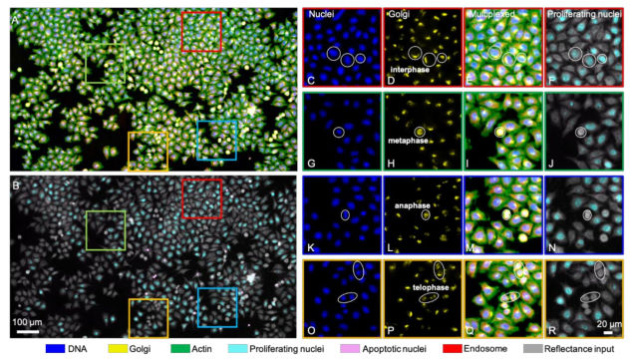
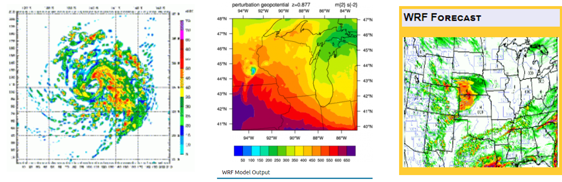
Notes:
Briefly introduce google colab: what it is, how to access it (through the link you give them), how does it look like,…

Slide 4
Machine Learning
Supervised
Unsupervised
Classification
Regression
Clustering
Dimensionality
Reduction

Slide 5
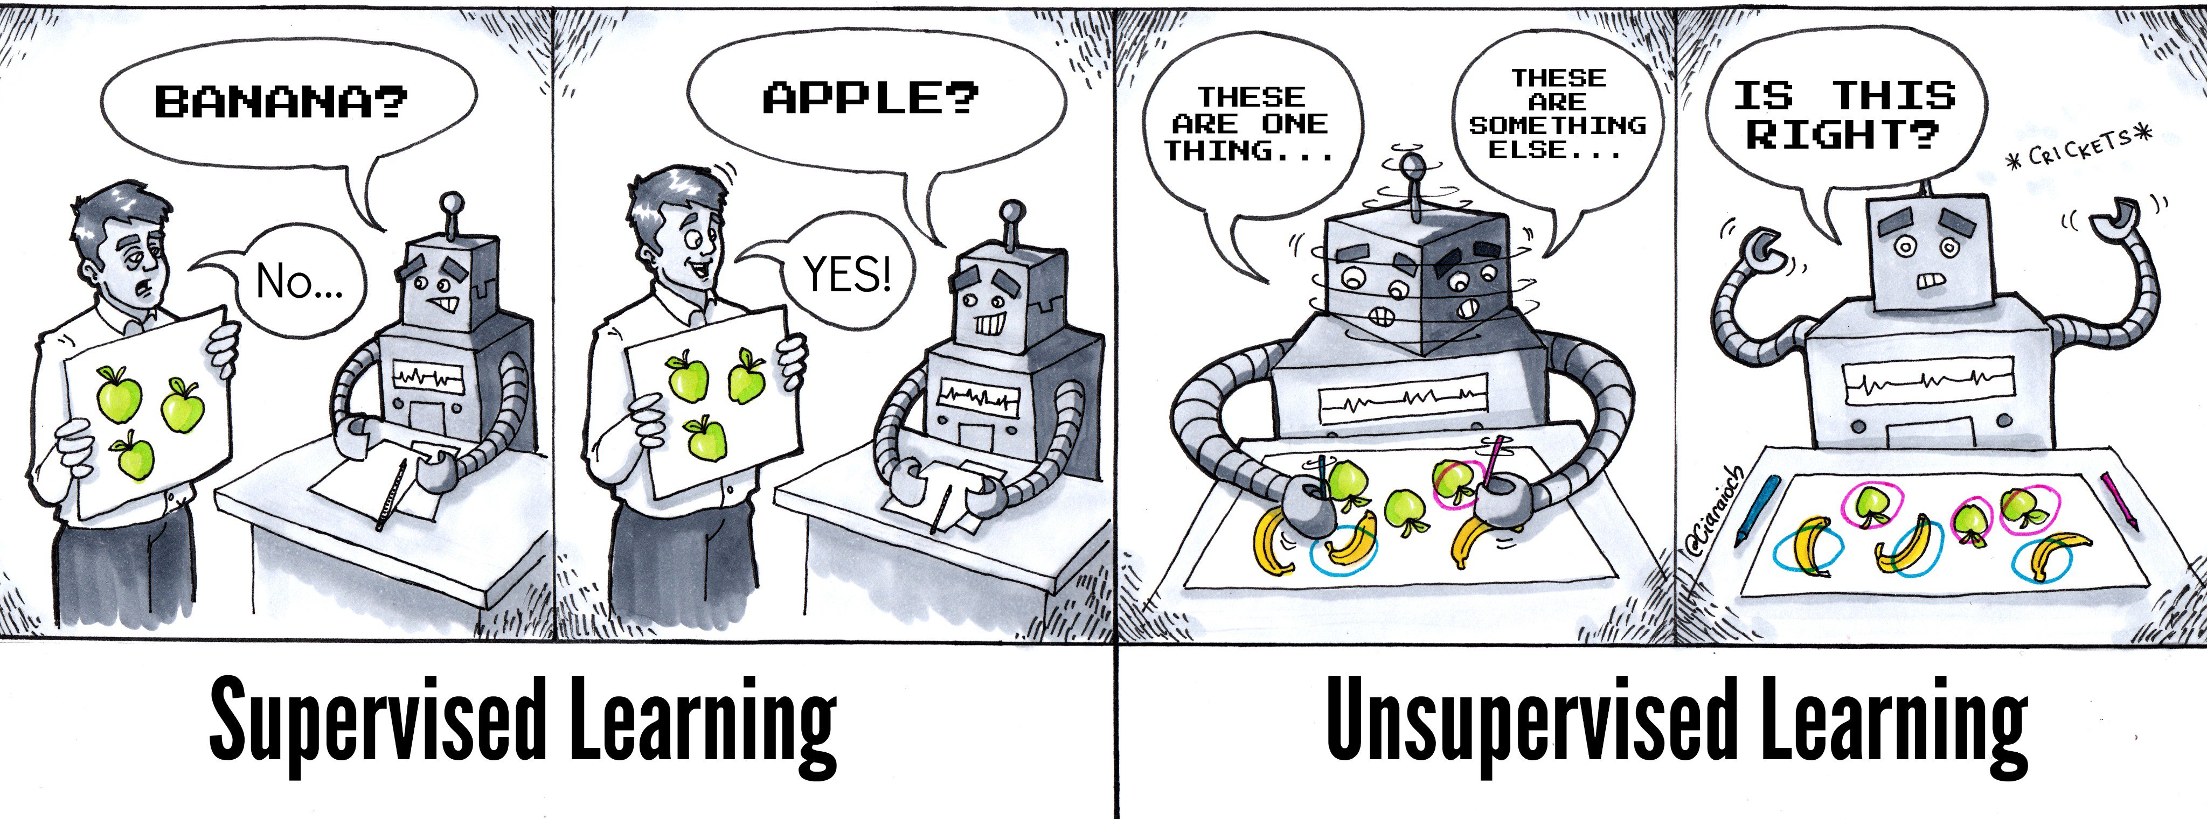

Slide 6
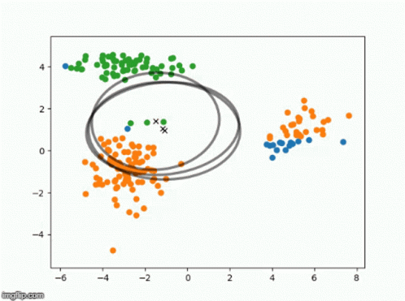
What is Clustering?
Clustering is the task of dividing the population or data points into a number of groups such that data points in the same groups are more similar to other data points in the same group than those in other groups. In simple words, the aim is to segregate groups with similar traits and assign them into clusters

Slide 7
What is K-means?
k-means clustering is a method of vector quantization, originally from signal processing, that aims to partition n observations into k clusters in which each observation belongs to the cluster with the nearest mean, serving as a prototype of the cluster.
-Wikipedia

Slide 8
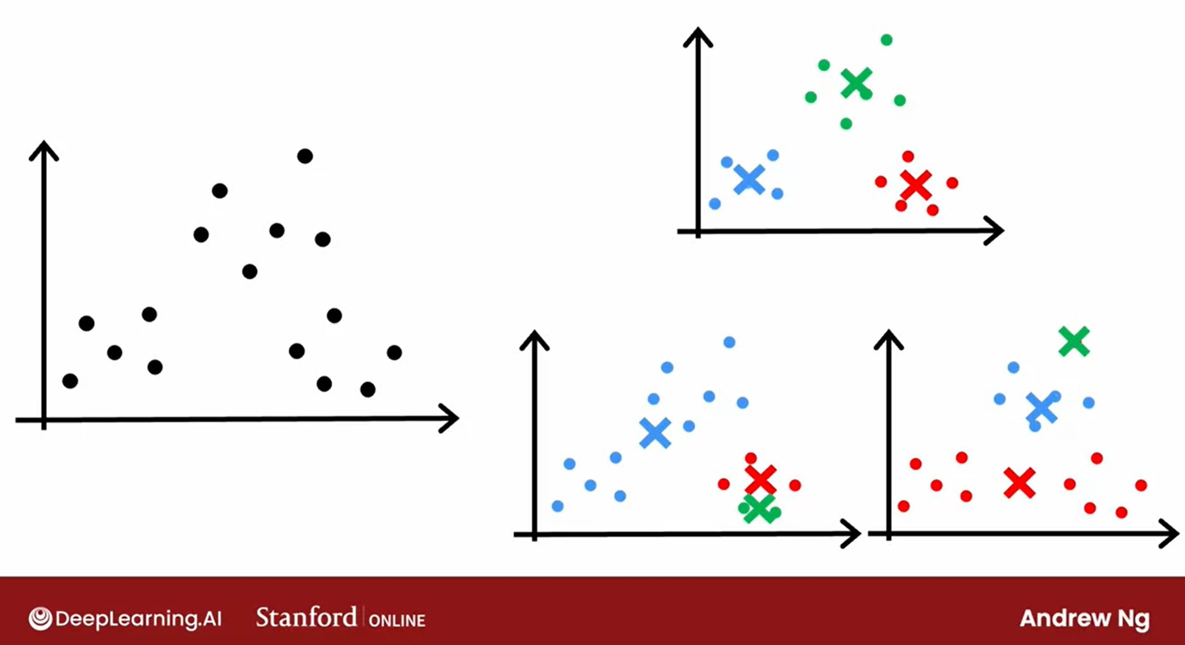
How to initialize K?

Slide 9
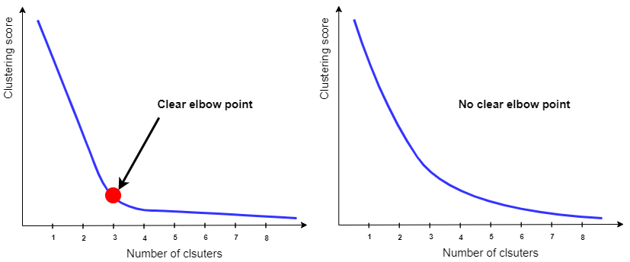
How many clusters should there be?

Slide 10
Idea Behind K Nearest Neighbours
It classifies the data point of the basis of how it’s neighbours are classified.
Feature 1
Feature 2

Slide 11
How does the KNN algorithm works?
CLASS | EUCLIDEAN DISTANCE
TRIANGLE | 5.46
TRIANGLE | 2.3
CIRCLE | 2
CIRCLE | 4.1
TRIANGLE | 1
CIRCLE | 3
TRIANGLE | 2.1
CIRCLE | 2.5
CIRCLE | 3.4
CLASS | EUCLIDEAN DISTANCE
TRIANGLE | 5.46
TRIANGLE | 2.3
CIRCLE | 2
CIRCLE | 4.1
TRIANGLE | 1
CIRCLE | 3
TRIANGLE | 2.1
CIRCLE | 2.5
CIRCLE | 3.4
Feature 1
Feature 2

Slide 12
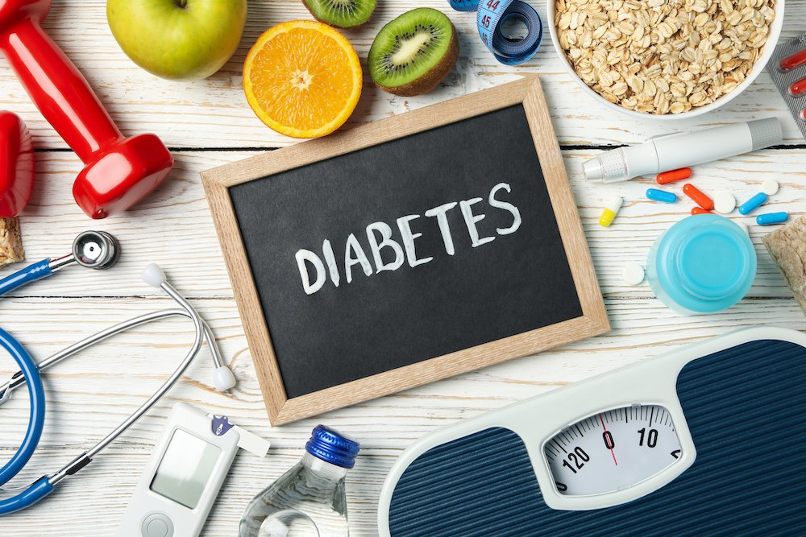
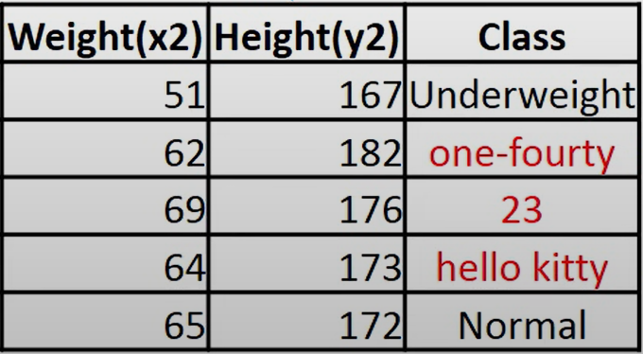

When do we use KNN?
Labelled
Small Datasets
Noise free

Slide 13



How do you decide how many numbers of K?
K should be in odd numbers.
You can choose K as sqrt(n)

Slide 14
Feature 1
Feature 2

